Slide 1
Functional Programming
Using Java 8

Slide 2
Different Programming Paradigms
Procedural
Gave us basic looping constructs and subroutines.
To abstract away from GOTO statements (assembly programming)
OO
Gave us classes and objects
To abstract away from Global state
Functional
Gave us Functions
Remove all state
Notes:
A multi-paradigm programming language is a programming language that supports more than one programming paradigm.
Java, Scala, C#

Slide 3
So what is Functional Programming
A style of building the structure and elements of computer programs—that treats computation as the evaluation of mathematical functions and avoids changing-state and mutable data.
In functional code, the output value of a function depends only on the arguments that are input to the function, so calling a function “f” twice with the same value for an argument x will produce the same result f(x) each time.
Source - https://en.wikipedia.org/wiki/Functional_programming
Notes:
Consistent result on all platform
Include Pure Functions

Slide 4
Why?
Concise
Expressive
Keep us focused
Reads like problem statement
Transparent not opaque
Easier to test due to purity
Easier to optimize
Easier to make concurrent

Slide 5
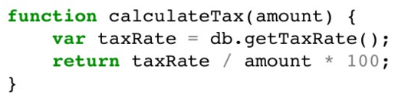
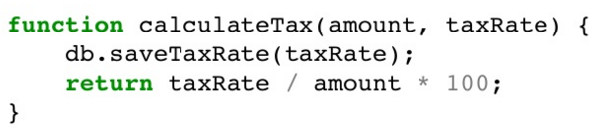

Key Features
Purity – Consistently same results – Always

Slide 6
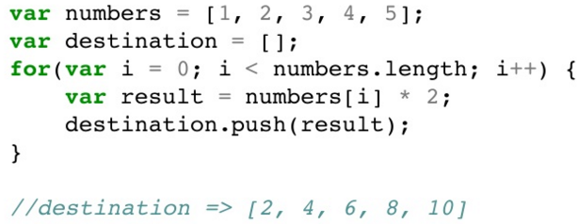
Key Features
Higher Order Functions – Input (functions) → Output (function)
Map
Filter
Readability – Describe what you want, not how you want.
Abstract iterations and filtering
Write functions to deal with elements, don’t get tangled in sequence.
Maintainability – Small independently testable functions
Concurrency

Slide 7
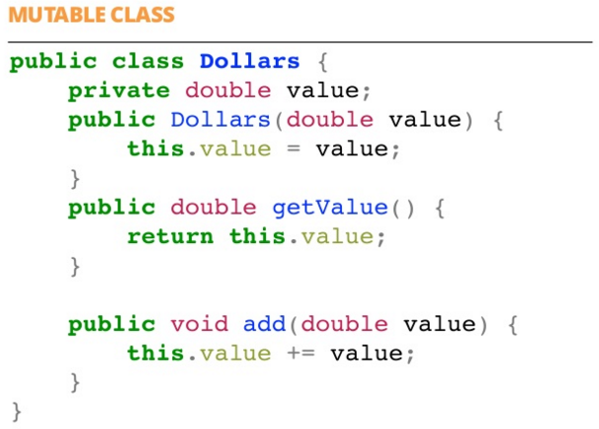
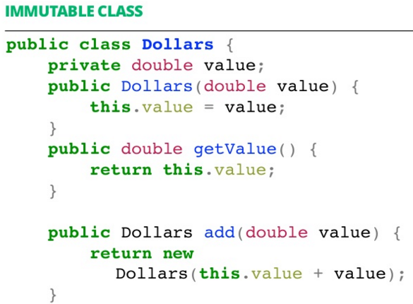
Key Features
Immutability -

Slide 8
What language support this?
Try to write small pure method – As much as possible
Avoid state – wherever you can
Create immutable
Prepare for concurrency

Slide 9
Where To Use?
Replacement Anonymous Class
Mathematical Operations
Iterations / Looping
Runnable
Operations on Collections -> Sorting, Filtering

Slide 10
How To Use?
Code Kata
Design Pattern within examples
Example from Platform – ServiceIntervalService.java

Slide 11
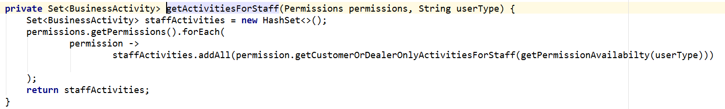
Guess the design pattern…
Iterator

Slide 12
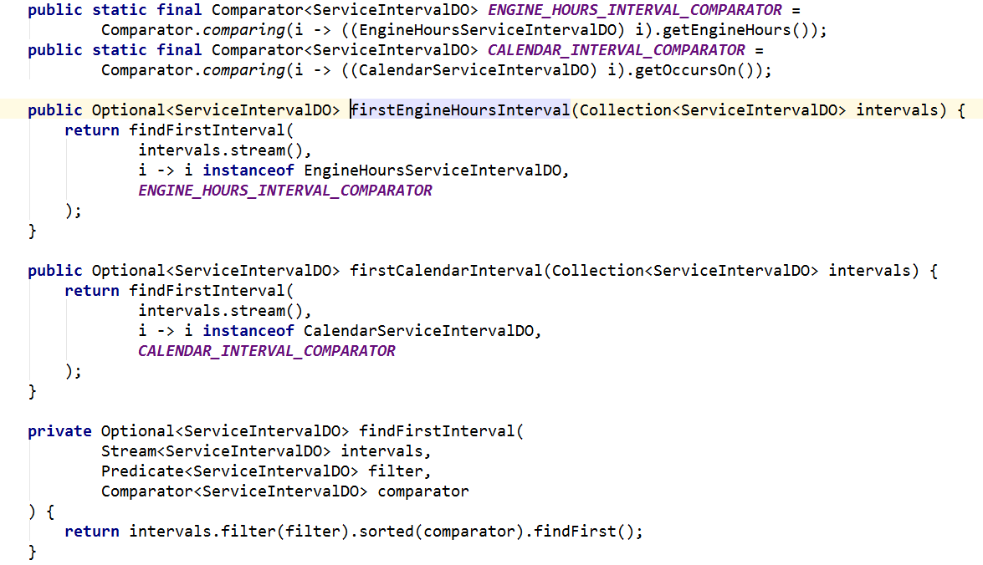
Delegate & Strategy

Slide 13
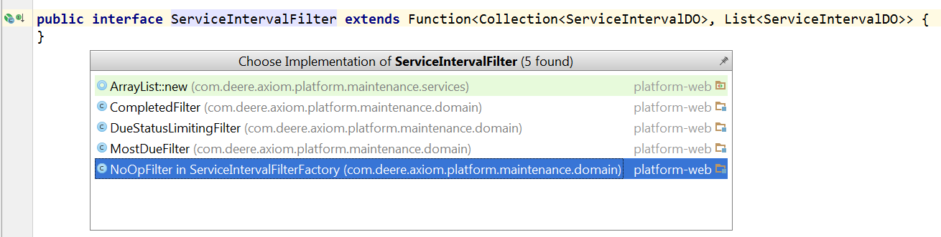
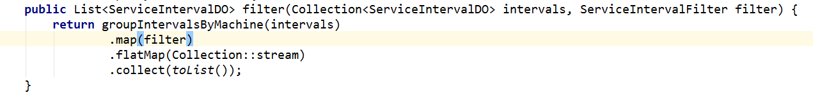
Strategy

Slide 14
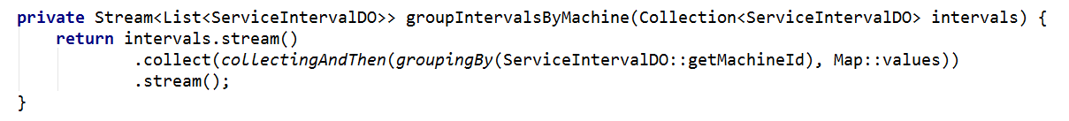
Decorative & Fluent Interface

Slide 15
Assignment
Codebase – Axiom Platform
ApplicationTotalTypes.java
PartnerProcessor.java -> getNSMPermissions(…)
AxiomSearchUtility.java -> search(…)
Codebase – mamos-services
AlertNodeServiceImpl.java -> getPaginatedAlerts(…)
AlertAkkaHelperImpl.java -> getAlerts(…)
Codebase – ece-java-component
TranslationServiceImpl.java
MeasurementDaoImpl.java

Slide 16
Assignment
Steps for assignment in Functional_Programming_Java:
Checkout the repo. (Contact Madhavi Selokar for access issues)
Copy the below classes in ‘com.deere.isg.lambda.solution’ package.
Rename it with your name / team name.
Commit and Push the changes.
Codebase - Functional_Programming_Java
Assign1.java (Problem statements are present in class)
Assign2.java (Problem statements are present in class)
Github Repo for Reference
https://github.deere.com/ms00146/Functional_Programming_Java
https://github.deere.com/MyJohnDeere/collections-commons

Slide 17
Books and Links
https://manning-content.s3.amazonaws.com/download/b/349f3c0-4e13-4929-9fc7-e596baa3e31c/Saumont_FPiA_MEAP_V08_ch1.pdf
http://www.developer.com/java/understanding-lambda-enabled-design-patterns.html
https://www.youtube.com/watch?v=OhRhvaM-lQ4 - The Joy of Functional Programming Keynote by Venkat Subramaniam
https://www.typesafe.com/resources/case-studies-and-stories/the-play-framework-at-linkedin
https://pragprog.com/magazines/2013-01/functional-programming-basics
Functional Programming Basics – By Robert C. Martin (Uncle Bob)
Functional Programming in Java : Harnessing the Power of Java 8 Lambda Expression – By Venkat Subramaniam

